Slide 18

Poverty In India
www.studymafia.org
Submitted To: Submitted By:
www.studymafia.org www.studymafia.org

Slide 19
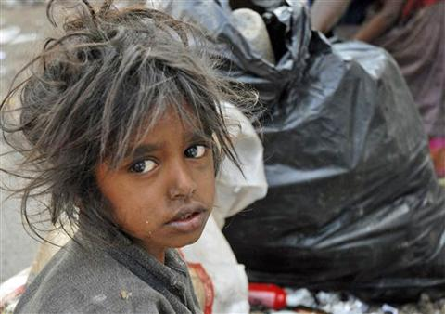
Presentation Flow
What is Poverty?
Poverty in India
Rural
Urban
Role of NGOs
Social Marketing for Poverty
What can we do?
Recommendations
Conclusion

Slide 20
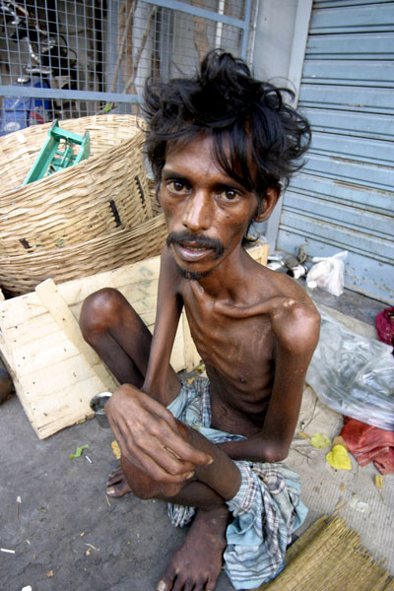
What is Poverty?
Poverty is hunger.
Poverty is lack of shelter.
Poverty is being sick and not being able to see a doctor.
Poverty is not having access to school and not knowing how to read.
Poverty is not having a job, is fear for the future, living one day at a time.
Poverty is losing a child to illness brought about by unclean water.
Poverty is powerlessness, lack of representation and freedom.

Slide 21
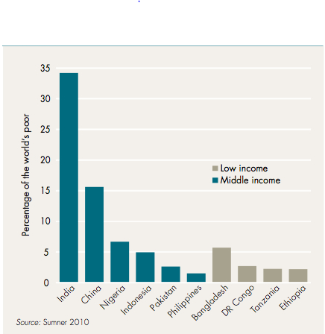
Poverty in India
Despite the growth and development of the Indian economy during the last couple of decades, poverty is, parallel, increasing in absolute terms.
The bare fact is that nearly 27.5 % of India’s population still lives below the poverty line, and 75 % of this, lives in rural areas.
A recent report laments that 77 % of Indians live on a daily income of Rs.20 only.

Slide 22
(Rural)
About two thirds of India’s more than 1 billion people live in rural areas, and almost 170 million of them are poor.
Although many rural people are migrating to cities, 3 out of 4 of India’s poor people live in the vast rural parts of the country.
Poverty is deepest among scheduled castes and tribes in the country’s rural areas. India’s poorest people include 50 % of members of scheduled tribes and 40 % of people in scheduled castes.
On the map of poverty in rural India, the poorest areas lie in parts of Rajasthan, Madhya Pradesh, Uttar Pradesh, Bihar, Jharkhand, Chhattisgarh, Orissa and West Bengal.
In these areas shortages of water and recurrent droughts impede the transformation of agriculture that the Green Revolution has achieved elsewhere.

Slide 23
Causes of Rural Poverty
Rapid Population Growth
With 1,210,000,000 (1.21 billion) people, India is currently the world's second largest country.
From the total population of India 68.84% people live in rural area of India and are growing very fast if we see the statistics of past few decades.
Lack of Capital
People basically depend on farming and agriculture in the rural areas but due to lack of sufficient capital they are not able to do their farming activities and earn, so they become poor and go below poverty line.

Slide 24
Lack of literacy
Many children living in rural areas receive a level of education which is very poor. Overall enrollment in primary and middle schools are very low.
50 % of children living in these areas leave school before the fifth grade.
These children leave school for variety of reasons: some leave because of lack of interest; most leave so that they can work in the fields, where the hours are long and the pay is low.
A large percent of the dropouts are females. Forced by their parents, most girls perform chores and tend the family at home.
These are some of the reasons why 60% of all females in India are illiterate, a figure much higher than those of males. As these children grow into adults, many are still illiterate by the age of forty

Slide 25
Large Families
Generally in rural areas there is large number of people living in one family. This happens because of two reasons.
First there is a lack of proper family planning in the rural areas among the villagers, which increases the population.
Secondly the people in the rural areas believe in living in one single families rather than living in nuclear families. This increases the burden of number of people to be fed in the house and also increases the expenses.
Lack of Alternate Employment Opportunities Other than Agriculture
The villagers in the rural areas have no alternative solutions to earn their livelihood accept farming as very few job opportunities are their in the villages and even if there are any job opportunities except farming the money available is not good.

Slide 26
Government’s Initiatives
For Employment
Jawahar Gram Samriddhi Yojana (JGSY) (Formerly known as Jawahar Rozgar Yojana)
Training rural youth for self employment TRYSEM Scheme
Sampurna Gramin Rozgar Yojana
National Rural Employment Guarantee Scheme
For Family Planning
Family Planning / Welfare Program for Population Control
For Farmers Insurance
Group Life Insurance Scheme for Rural Areas
Agriculture Income Insurance Scheme

Slide 27
For Housing
Rural Housing Program
For Development
Small Farmer Development Program (SFDP)
Drought Area Development
Pradhan Mantri Gramodaya Yojana (PMGY)
Swarna Jayanti Gram Swarozgar Yojana
Integrated Rural Development Program

Slide 28
(Urban)
As per the latest NSSO survey reports there are over 80 million poor people living in the cities and towns of India. The Slum population is also increasing and as per TCPO estimates 2001; over 61.80 million people were living in slums.
The bulk of the urban poor are living in extremely deprived conditions with insufficient physical amenities like :
Low-cost water supply,
Improper sanitation,
Bad Sewerage and drainage system,
Very less social services relating to health care, nutrition, pre-school and non-formal education.

Slide 29
With over 575 million people, India will have 41% of its population living in cities and towns by 2030 of its nearly 1 billion inhabitants, an estimated 260.3 million are below the poverty line, of which 193.2 million are in the rural areas and 67.1 million are in urban areas.
The poverty level is below 10% in states like Delhi, Goa, and Punjab etc whereas it is below 50% in Bihar (43) and Orissa (47). It is between 30-40% in Northeastern states of Assam, Tripura, and Mehgalaya and in Southern states of TamilNadu and Uttar Pradesh.

Slide 30
Causes of Urban Poverty
Slow job growth
Increasing Urban population (currently around 38 crore)
Severe competition.
Those who use to get jobs or promotions easily now have to struggle more due to the population hike in the cities.
Migration of Rural Youth towards Cities
Majority of rural area depends on agriculture (which is highly dependant on rain patterns)
Inadequate rain fall and improper irrigation facilities these days.
Low or no production of crops which leads to severe poverty among rural population.
Urban poverty also increases due to migration of people from rural areas to cities

Slide 31
Voicelessness’ And Powerlessness
Many times it is seen that people are not able to raise their voice against the ill social practices prevalent in the cities and town.
The local “Mafias” take “Hafta” from the street hawkers, leaving very less amount of money for their living.
Even voice is not raised against wrong political activities and elements.
Lack of Housing Facilities
There is a limited asset base for individuals, households or communities (including both material assets such as housing and capital goods, and non-material assets such as social and family networks and ‘safety nets’.

Slide 32
Public Distribution System (PDS)
The Public Distribution System (PDS) continues to absorb substantial public resources at almost 1% of GDP.
While it covers up to 25% of the households, its benefits for the poor have been limited.
Leakage and diversion of grains from the PDS are high.
Only 41% of the grains released by the government reach households, according to 2004-2005 NSS, with some states doing much worse.

Slide 33
Government’s Initiative
For Employment
Nehru Rozgar Yojana (NRY)
Self – Employment Program for the Urban Poor (SEPUP)
Prime Minister’s Rozgar Yojana (Also implemented in rural areas)
Swarna Jayanti Shahri Rozgar Yojana
Self – Employment to the Educated Urban Youth (SEEUY) Program
For Housing
Financial assistance for Constructing Houses
Other Programmes
Urban Basic Services for the Poor (UBSP) Program
Prime Minister’s Integrated Urban Poverty Eradication Program (PMIUPEP)

Slide 34
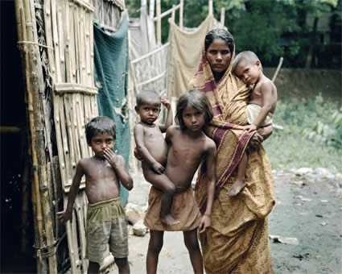
In line of these approach, NGOs have developed various strategies to influence the process of public policy making and to control the implementation of development programs or projects.
Few NGOs in Ahmedabad
Jyoti Sangh
Apang Manav Mandal
VidhyaNagar Sewa Sameeti
Shivbaba Shraddha Kalyan Association
Shree Manglay Seva Kelavani Mandal

Slide 35
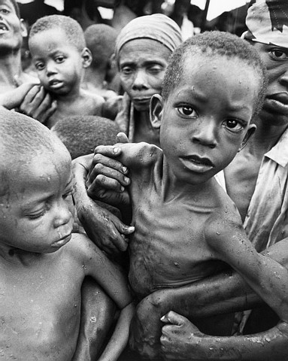
Social Marketing for Poverty
Developing a Social Marketing Plan
Step 1: Background, Purpose, and Focus
Step 2: Situation Analysis
Step 3: Target Audience Profile
Step 4: Marketing Objectives and Goals
Step 5: Factors Influencing Adoption of the Behavior
Step 6: Positioning Statement
Step 7: Marketing Mix Strategies
Step 8: Plan for Monitoring and Evaluation
Step 9: Budget
Step 10: Plan for Implementation and Campaign Management

Slide 36
What can we do?
In our own small way,
let us not waste resources,
the fruit of hard earned tax payer’s money,
which might better be used to eradicate the misery of others.
Let us show that we do care and
realize the dream of seeing a poverty free India.

Slide 37
How To Eliminate Poverty?
Widening the concept of employment
Ensuring financial services even to the poorest person
Recognizing every single human being as a potential entrepreneur
Recognizing social entrepreneurs as potential agents for creating a world of peace, harmony, and progress
Recognizing the role of globalization and information technology in reducing poverty.

Slide 38
Recommendations
Launch large-scale infrastructure construction.
Establishing agric-technology extension service network basically covering the whole country.
Setting up national rural cooperative credit system and their efficient functioning.
Pushing forward rapid development of rural as well as urban fundamental education and basic medical care.
Preliminarily setting up rural as well as urban social security system with focus on community’s developmental system and assistance to extremely poor people.

Slide 39
Conclusion
Though India shows a high economic growth, it is shameful that there is still large scale poverty in India.
India has the world's largest number of poor people living in a single country.
Poverty in India can be defined as a situation when a certain section of people are unable to fulfill their basic needs.
Hunger, malnutrition and susceptibility of poor to natural disasters make them take up anti national and anti social activities
It is the duty of the governments in particular and all citizens in general to try their best to alleviate poverty to establish harmony and peace in the societies and in the world.

Slide 40
References
Wikipedia
Google
Studymafia.org

Slide 41
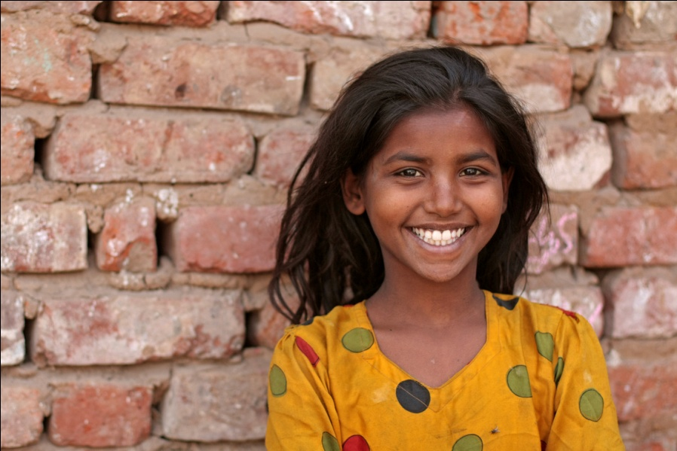
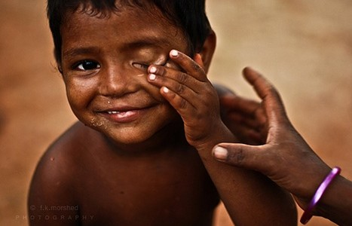
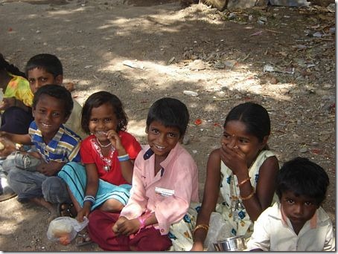
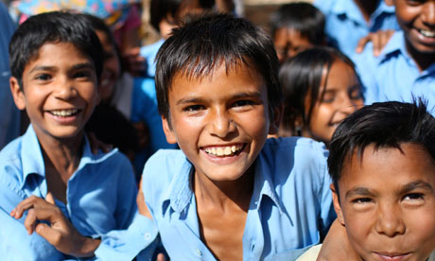
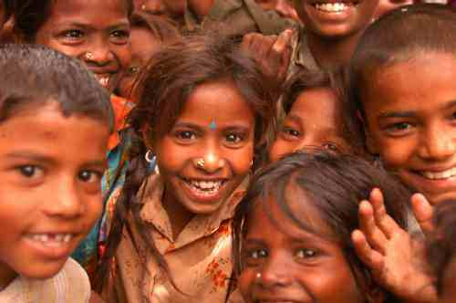
Help Us
Be a Human
Thank You

